Slide 1

Trainer: Going to class without a lesson plan is like going to cook without a recipe.
Participant: Sir, what is cooking without a recipe?
Trainer: Hotchpotch (Khichuri)
Participant: Then there is no need a lesson plan,
Trainer: Why?
Participant: Hotchpotch (Khichuri)
is my favorite food.

Slide 2
LESSON PLAN
By M A BASHAR

Slide 3
WHO IS LESSON PLAN FOR?
It’s not for the students

Slide 4
WHO IS LESSON PLAN FOR?
It’s for you !!!

Slide 5
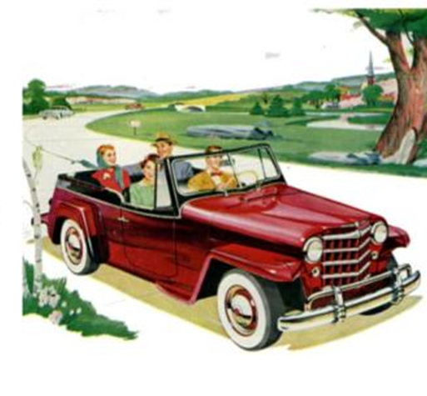
WHY FOR YOU?
It shows you where you start, where
You finish.

Slide 6
Makes class regular & organized
saves time & Energy
Stay on track
Helps teachers to avoid “unpleasant” surprises
Gives teachers confidence
Discipline in the class

Slide 7
Provides Clear Learning Objectives
Organizes Content for Better Understanding
Encourages Active Participation
Encourages building Independent Learning habit

Slide 8
Specific
Measurable
Attainable
Realistic
Time bound

Slide 9
student-centered, flexible, complete, interesting & activity-based.

Slide 10
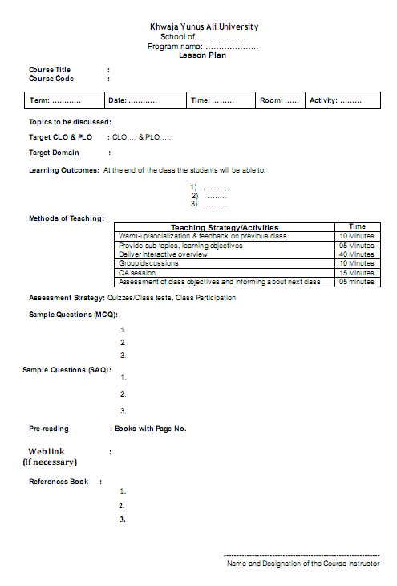

Slide 12
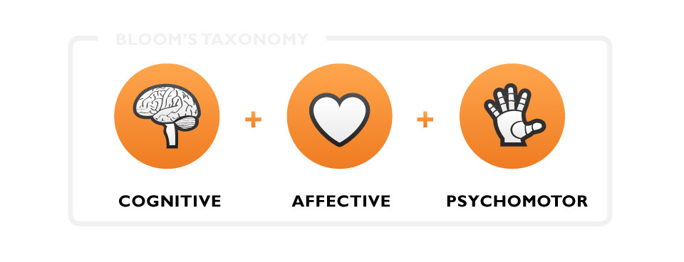

Slide 17
THE END
If you fail to plan, you plan to fail. ~Benjamin Franklin
THANK U

